Slide 1
From Courtside to Spreadsheet: Unveiling Basketball Analytics
Players: Peter Hoagland, Alena Matusevich, and Lillian Ruelas-Thompson

Slide 2

Key points
NOTE:
To change images on this slide, select a picture and delete it. Then click the Insert Picture icon
in the placeholder to insert your own image.
Libraries used: Python Pandas, Python Matplotlib, Seaborn, Scikit-learn
ML models used: Decision Tree and Neural Network
Database: MongoDB
Data sources from Kaggle

Slide 3
Data Cleanup
Seasons_Stats.csv
Source: https://www.kaggle.com/datasets/drgilermo/nba-players-stats?resource=download
Size: 24691 x 53
Date: 1950 to 2017
Data per player on a team per year
Goal: Sumup and normalizes individual players performance to get performance per team since 2004 to 2017
X or independent variables
Ranking.csv
Source: https://www.kaggle.com/datasets/nathanlauga/nba-games
Size: 193092 x 13
Date: 2003-10-01 to 2021-05-26
Data per team per season
Goal: Get wins per team per season from 2004 to 2017 and join it with season_stats_final_df
Y or dependent variable
Project Goal: Based on team performance statistics predict the number of wins per team.

Slide 4
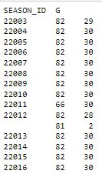
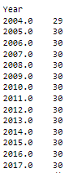
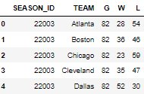
Data Preparation
Ranking_final_df
Data size: 419 rows (2004 to 2017)
Number of G (games) played by how many teams per season
To join it to the Season_stats_fanal 2 lookup documents were created to convert from SEASON_ID to Year and form TEAM full name to abbreviation and join on both fields
Seasons_Stats_final
Data size: 419 rows (2004 to 2017)
Number of teams played per year
Has 6 calculated fields that are X or independent variables for ML model

Slide 5
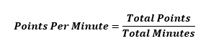
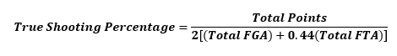
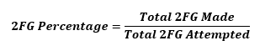
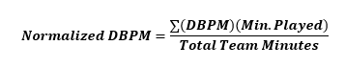
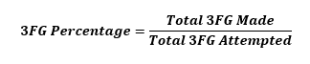
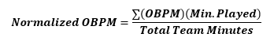
Six Main Features

Slide 6
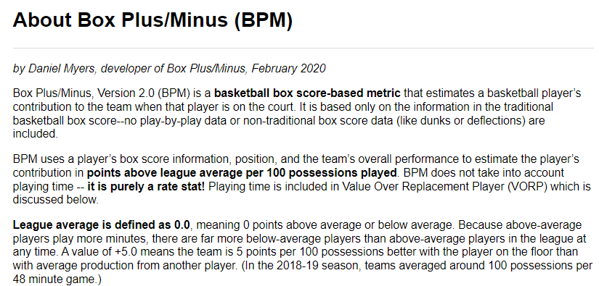
From Basketball-Reference.com
From: https://www.basketball-reference.com/about/bpm2.html

Slide 7
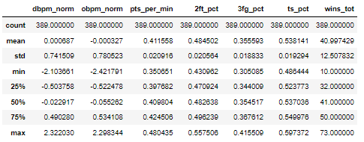
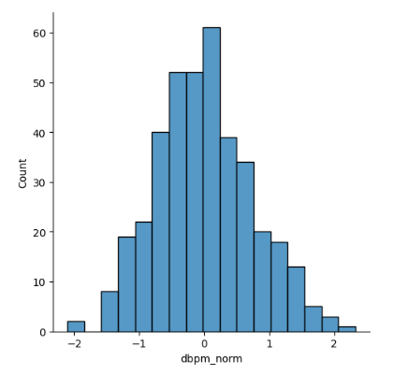
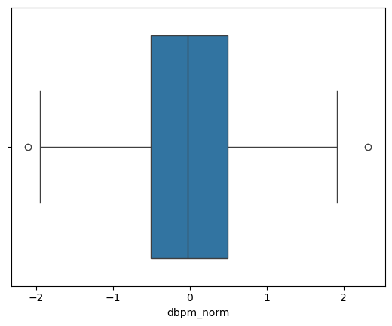
Data Statistics
Data Distribution: dbpm_norm and obpm_norm mean and mediam are different from each other. However, the histogram plots look like normal distribution. For the rest of the columns mean and mediam are aproximatly the same and the hystogram looks normaly distributes. Thus, standard scaler is the right type of scaler for this data.
Interesting to note that wins_tot mean and median is at 41 as expected because at most the team can have 0 wins and at most 82 wins.
Outliers: Removing outliers from dbpm_norm and obpm_norm didn't bring mean and median much closer together and didn't change much the distribution. Thus, it is best to leave outliers as they are a part of the real data.

Slide 8
Decision Tree Model
Initially, for the Decision tree model, we used ‘wins_tot’ as the outcome variable (y), and we dropped the ‘Tm’, ‘TEAM’, ‘wins_tot’, ‘Year’, ‘_id’ columns to use the rest of the data frame columns as our features.
The model gave a 95% accuracy score, as well as the classification report.
Actual accuracy score: 0.9487179487179487
Classification Report
 | Precision | Recall | F1-score | Support
Accuracy |  |  | 0.95 | 78
Macro avg | 0.90 | 0.90 | 0.90 | 78
Weighted avg | 0.95 | 0.95 | 0.95 | 78

Slide 9
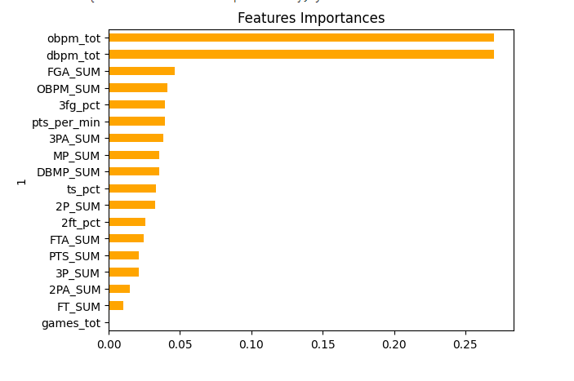
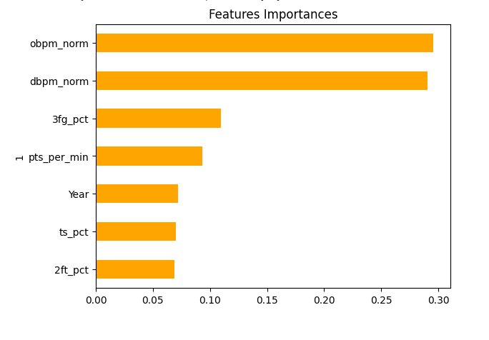
Decision Tree Features Importance
Initial Feature Importances
Final Feature Importances

Slide 10
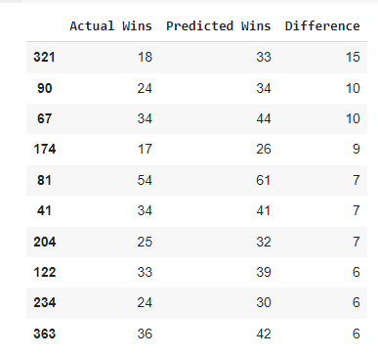
However…
Classification Report
 | Precision | Recall | F1-score | Support
Accuracy |  |  | 0.04 | 78
Macro avg | 0.02 | 0.02 | 0.02 | 78
Weighted avg | 0.05 | 0.04 | 0.04 | 78
We still used ‘wins_tot’ as the outcome variable (y), but we dropped most of the columns and only used, ‘Year’, ‘pts_per_min’, ‘2ft_pct’, ‘3fg_pct’, ‘ts_pct’, ‘dbpm_norm’, ‘obpm_norm’ columns as our features.
The model gave a 4% accuracy score, as well as the classification report.
However, when we ran an mean squared error and R2 score, it was more accurate.
RMSE: 5.614769899616637
R2 score: 0.7591540594298113

Slide 11
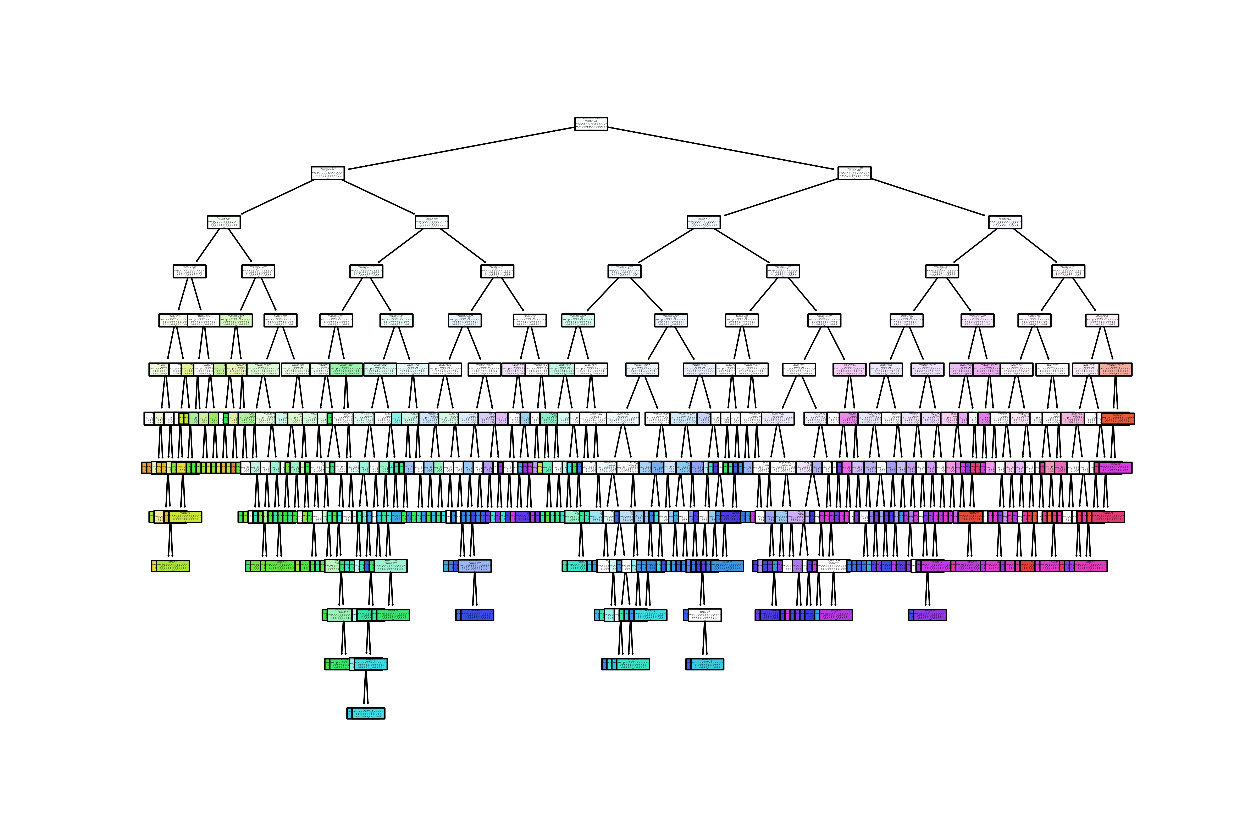
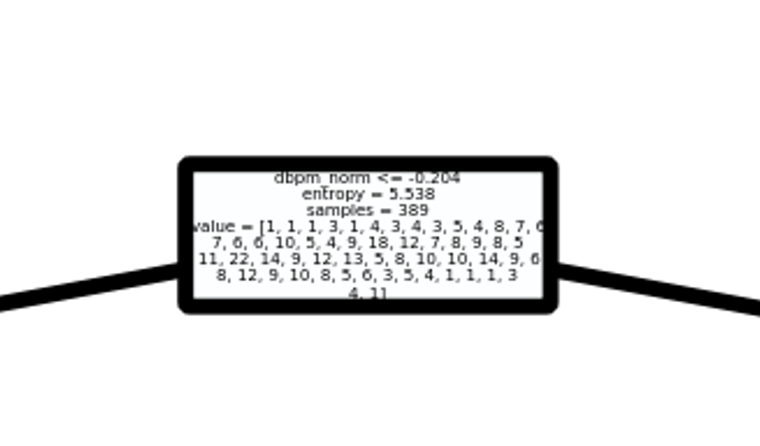
Decision Tree Visualization

Slide 12
Neural Network Model

Slide 13
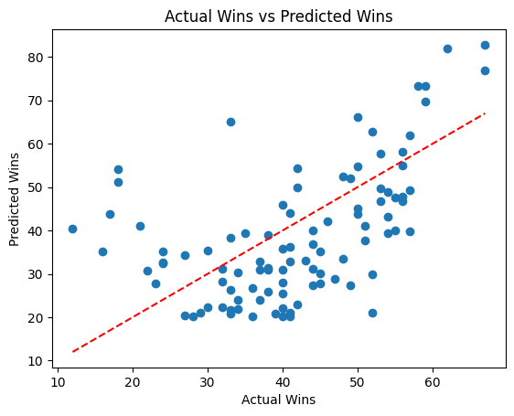
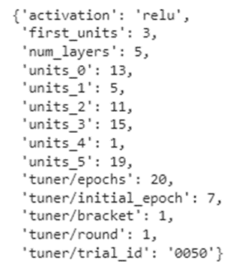
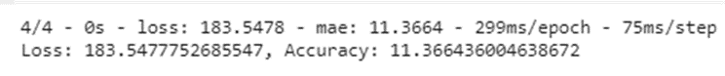
First Using Six Main Features

Slide 14
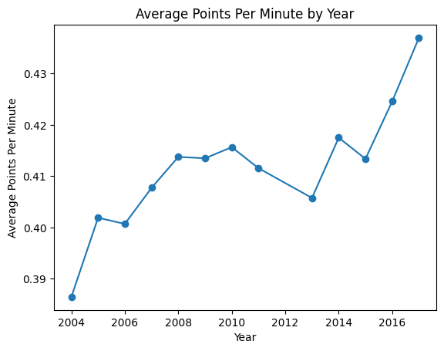
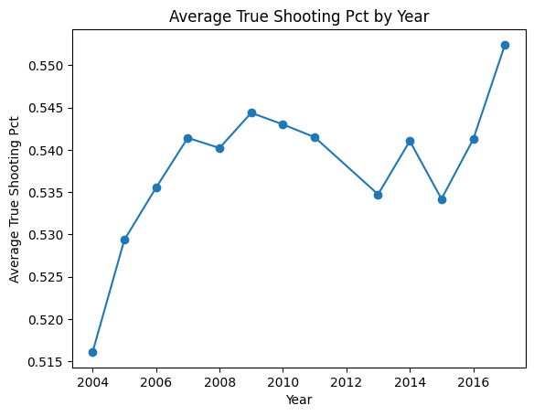
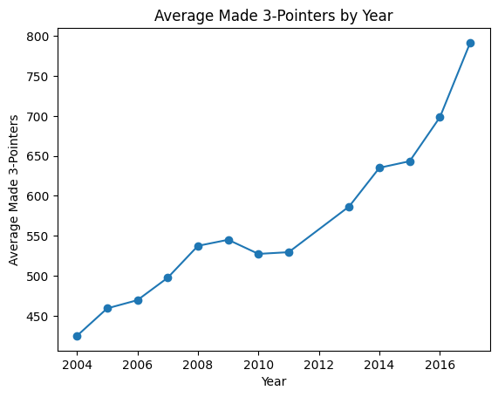
Shooting Trends (2004-2017)

Slide 15
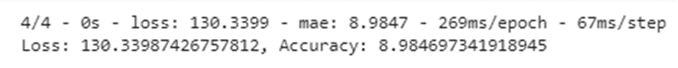
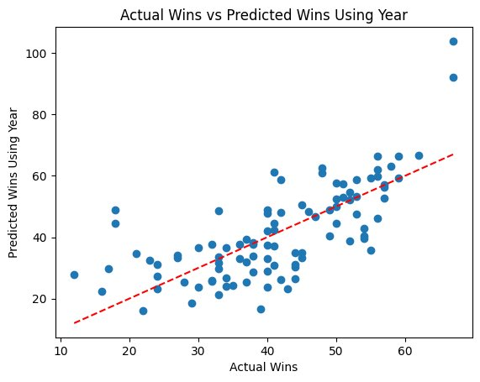
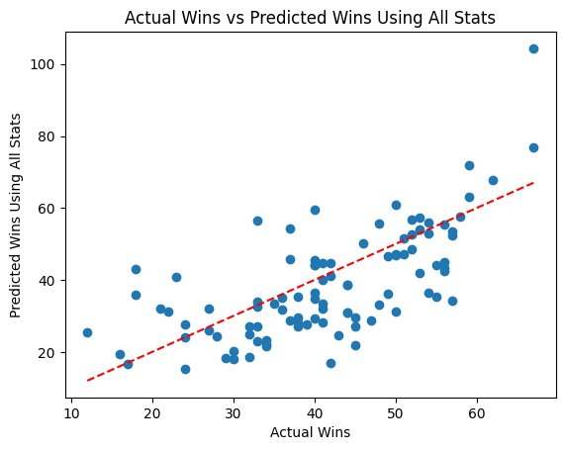
Incorporating Year and All Stats
Stats Used | Loss (Mean Square Error) | Accuracy (Mean Absolute Error)
Main Stats | 183.548 | 11.366
Main Stats + Year | 117.787 | 8.318
All Stats | 130.340 | 8.985

Slide 16
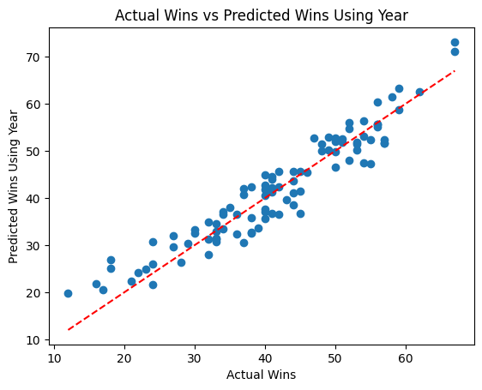
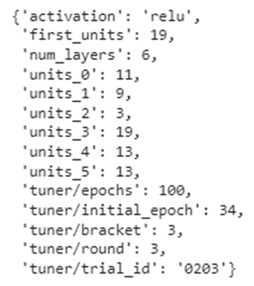
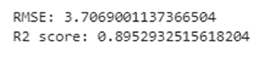
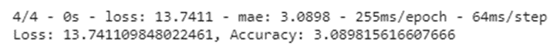
Run Keras-Tuner with Increased Epochs

Slide 17
1.What type of model generates the most accurate predictions for how a basketball team will perform (win total) in a given season?
Based on the data that was used the best type of model that gave the most accurate predictions was the Neural Network model, however, in using the decision tree model, we were able to see which features were more important than others, and how we needed to trim the columns to run both models.

Slide 18
2. What statistics fed into the model inform the model the most? Common statistics include a team’s previous record, offensive rating, defensive rating, and the team’s player’s individual statistics.
We used mostly the same columns and data points for each ML model, and we were able to determine that the obpm_norm (Normalized Offensive Box Plus/Minus) and the dbpm_norm (Normalized Defense Box Plus/Minus) informed both models the most. We also found that, due to shooting trends across the time period analyzed, including the Year improved the accuracy of both models.

Slide 19
Limitations
Not enough data points – Due to player statistics only going up to 2017 and team record statistics only going back to 2004, we were limited to data from 2004-2017
No possession data – Most models currently used in basketball use possession data (evaluate points scored, points allowed, rebounds, etc. per 100 possessions instead of per game or per minute). Possession data was not available in the data sets used.
Accounts for teams that play at different pace
Better for comparisons since, when two teams play each other, they will have essentially the same number possessions
Team A: Averages 100 points per game using 80 possessions per game, 1.25 pts/poss
Team B: Averages 110 points per game using 100 possessions per game, 1.10 pts/poss
Data mostly neglected defense - Other than Defensive Box Plus/Minus, the data used mostly pertained to team offense. If it had been available, including points each team allowed would have likely improved the model.

Slide 20
Future Use
Use with player projection models to predict a team's record before the season even starts
A complete player projection model would use each player's age/experience, statistics from previous years, and expected role on their current team to predict their stats for the coming season.
Player projection models for every player on a team's roster could be used to predict the same team stats used in our Neural Network model (TS%, 3FG%, OBPM, etc).
Running our Neural Network model with these expected team statistics would calculate a predicted Wins Total.

Slide 21
Slam Dunk?

